Slide 1
Capstone Engagement – Team 3
Assessment, Analysis, and Hardening of a Vulnerable System Muhammad Mirza, Pawal Stefaniak, Stephen Hallowich, Ameerah Abney, Bob Malin, Jonathan Gene, Joseph Mossman, Leslie Jackson, Ryan Marquette January 20th, 2021

Slide 2
Table of Contents
ES
Executive Summary
01
Network Topology
02
Red Team: Security Assessment
03
Blue Team: Log Analysis and Attack Characterization
Hardening: Proposed Alarms and Mitigation Strategies
04

Slide 3
Executive Summary
Team 3 used the learning of the last few months and was successfully able to play the role of Blue and Red team
This presentation will show how the team exploited target web server and and was able to use Kibana to identify actions from attack server
Hardening of the Capstone server along with enhanced monitoring options are added as part of the presentation

Slide 4
Network Topology
4

Slide 5
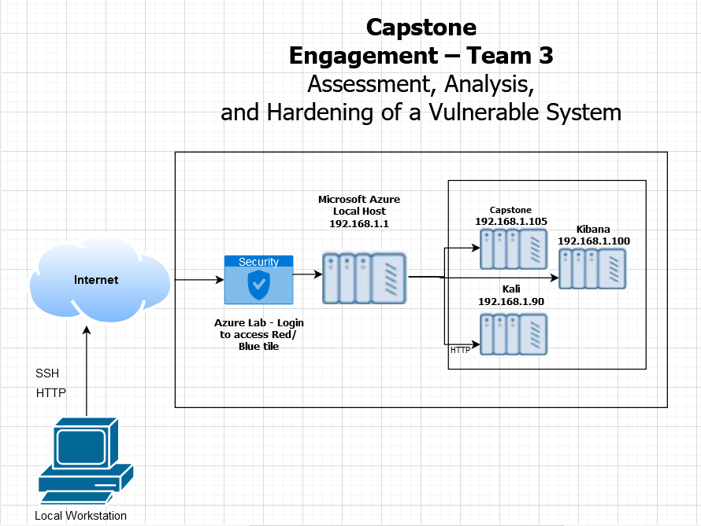
Network Topology
Network
Address Range: 192.168.1.0/24
Netmask: 255.255.255.0
Gateway: 192.168.1.1
Machines
IPv4: 192.168.1.100
OS: Windows
Hostname: Kibana
IPv4: 192.168.1.90
OS: Kali Linux
Hostname: Kali
IPv4: 192.168.1.105
OS: Kali Linux
Hostname: Capstone

Slide 6

Red Team
Security Assessment
6

Slide 7
Recon: Describing the Target
Nmap identified the following hosts on the network:
Hostname | IP Address | Role on Network
ELK | 192.168.1.100 | SIEM
Kali | 192.168.1.90 | Attack server
Capstone | 192.168.1.105 | Victim server
Azure VM | 192.168.1.1 | Local Host

Slide 8
Vulnerability Assessment
The assessment uncovered the following critical vulnerabilities in the target:
Vulnerability | Description | Impact
Easy to guess password | Password was easily exploitable using rockyou file | Easy to break into the server
No account lock feature after multiple tries | Used Brute Force attack to guess passwords | Easy to break into the server
Backdoor Remote Shell | Was able successfully deploy reserve shell payload | Helped gained a persistent access into the Capstone server
Company folders were easily accessible | Using Kali, team was able to browse most folders without any password, and the secret folder with just a simple “linux4u” password | Major security concern and potential confidential data loss

Slide 9
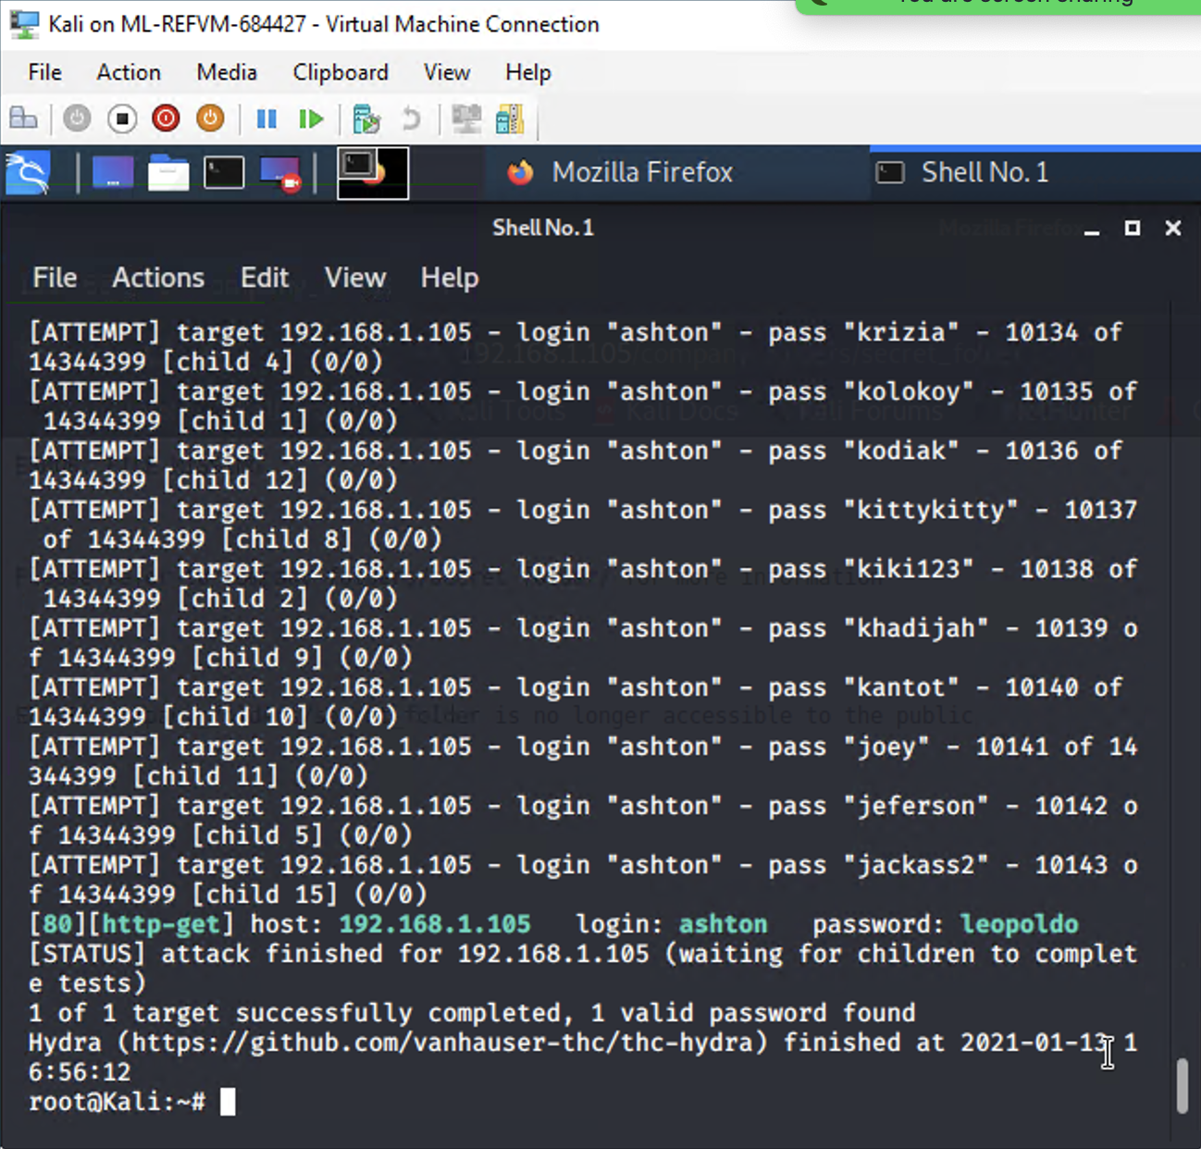
Exploitation: Easy to guess passwords
01
02
03
Tools & Processes
Installed rockyou.txt.gz file
Ran hydra to guess password
Crack Station website
Achievements
Exploit helped crack the password of the users

Slide 10
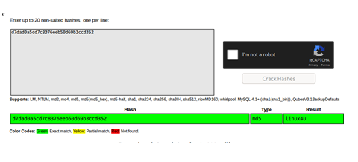
Exploitation: No Account lock feature
01
02
03
Tools & Processes
Was able to use brute force technique to crack password
Achievements
Team was able to crack and identify user passwords “linux4u” from Ashton and Ryan

Slide 11
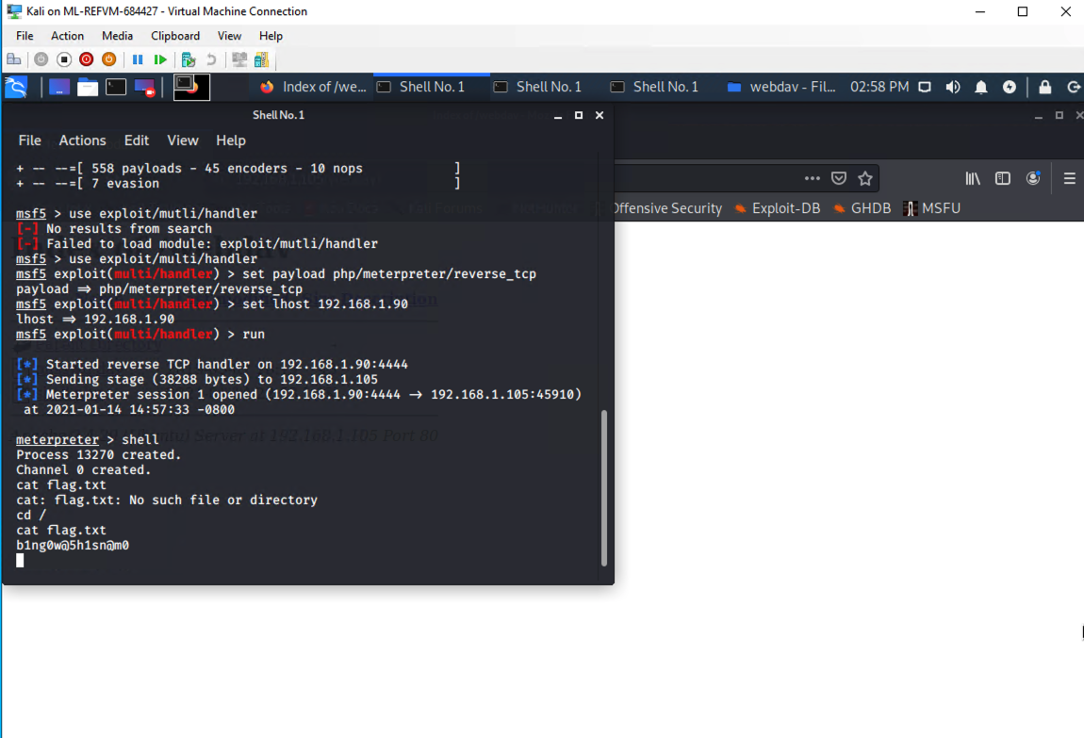
Exploitation: Backdoor Remote Shell
01
02
03
Tools & Processes
Shell scripting
MSFvenom
Meterpretor
Achievements
Team was able to get the backdoor into the Capstone Web Server

Slide 12
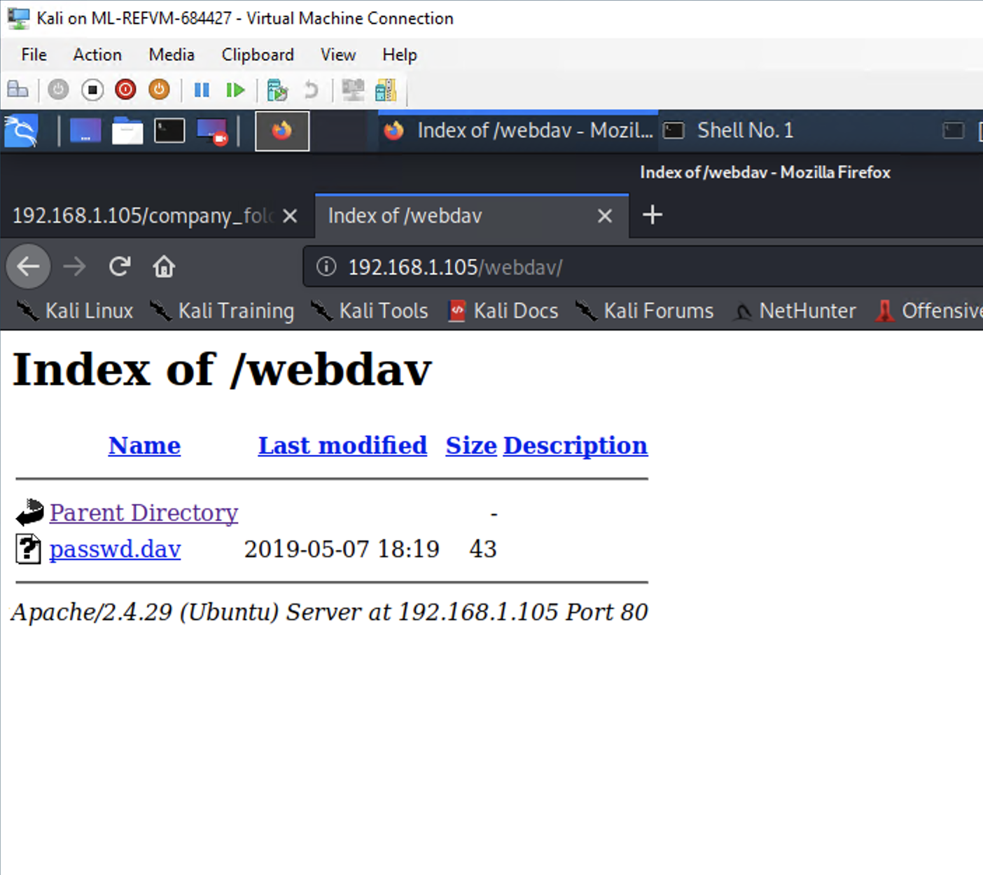
Exploitation: Company folders were easily reachable
01
02
03
Tools & Processes
As HTTP port was open, we were able to just use the IP address of the Capstone server and got it
Achievements
Team was able to browse most of the folders which had important information for us to use with directions to connect to the Corp server

Slide 13

Blue Team
Log Analysis and Attack Characterization
13

Slide 14

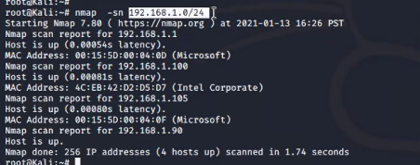
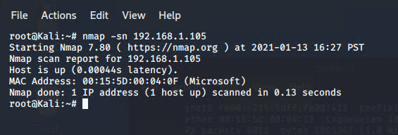
Analysis: Identifying the Port Scan
Answer the following questions in bullet points under the screenshot if space allows. Otherwise, add the answers to speaker notes.
What time did the port scan occur? 16:26 PST
How many packets were sent, and from which IP? 256 packets from 192.168.1.90
What indicates that this was a port scan? Running nmap -sn
[Insert Here]
Include a screenshot of Kibana logs depicting the port scan.

Slide 15
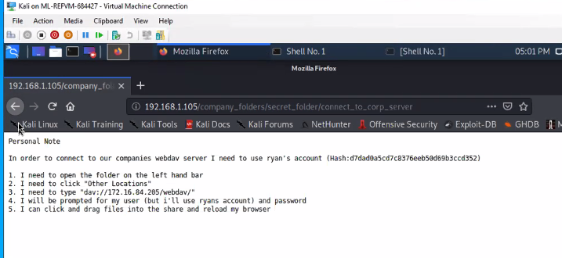
Analysis: Finding the Request for the Hidden Directory
Answer the following questions in bullet points under the screenshot if space allows. Otherwise, add the answers to speaker notes.
What time did the request occur? Saturday 11am-2pm. How many requests were made? At least five requests.
Which files were requested? What did they contain? Screen shot below.
Team was able to access the hidden folder (corp_server) multiple times, but Kibana dashboard did not show that folder was access by us.
We presented the data to TA-Jeff and completely removed the dashboard and repeated the process and it still did not show what we needed.

Slide 16
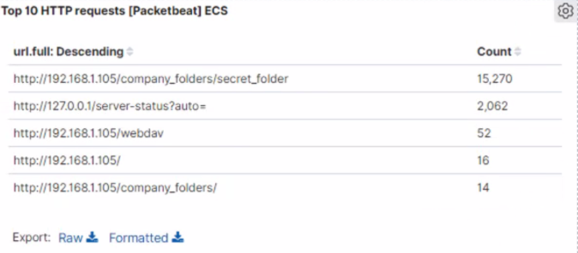
Analysis: Uncovering the Brute Force Attack
Answer the following questions in bullet points under the screenshot if space allows. Otherwise, add the answers to speaker notes.
How many requests were made in the attack? 15,265
How many requests had been made before the attacker discovered the password? 15,270

Slide 17
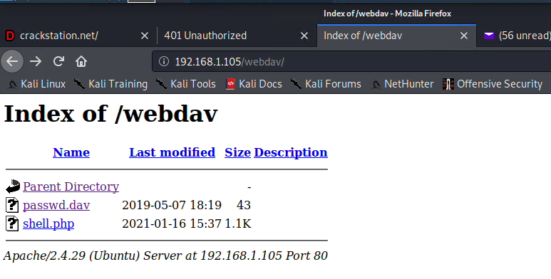
Analysis: Finding the WebDAV Connection
Answer the following questions in bullet points under the screenshot if space allows. Otherwise, add the answers to speaker notes.
How many requests were made to this directory? 52
Which files were requested? Shell.php

Slide 18
Blue Team
Proposed Alarms and Mitigation Strategies
18

Slide 19
Mitigation: Blocking the Port Scan
What kind of alarm can be set to detect future port scans?
Install IDS and have it generate an alert anytime it detects a scan is being performed
What threshold would you set to activate this alarm?
Generate an alert if multiple IPs and ports are scanned in over 1 second time frame
What configurations can be set on the host to mitigate port scans?
On the local host files, explicit access list should be added, so only trusted devices can access the host
Describe the solution. If possible, provide required command lines.
Create rules
/sbin/iptables -A INPUT -p tcp --destination-port {PORT-NUMBER-HERE} -j DROP

Slide 20
Mitigation: Finding the Request for the Hidden Directory
What kind of alarm can be set to detect future unauthorized access?
Generate a severity 2 alarm anytime hidden directory
What threshold would you set to activate this alarm?
If the hidden directory exceeds more than 4 attempts during business hours, generate an alert
What configuration can be set on the host to block unwanted access?
In Active Directory, make accessing the hidden folder a privileged access, which normal group does not have
Create a two factor authentication company wide

Slide 21
Mitigation: Preventing Brute Force Attacks
What kind of alarm can be set to detect future brute force attacks?
Set a threshold alarm to trigger if more than 10 attempts are made in an hour
What threshold would you set to activate this alarm?
10 attempts in an hour
What configuration can be set on the host to block brute force attacks?
Multi factor authentication
Lock user account for an hour after 3 failed attempts

Slide 22
Mitigation: Detecting the WebDAV Connection
What kind of alarm can be set to detect future access to this directory?
Set an alarm to trigger if HTTP PUT request is made on the Dav directory
What threshold would you set to activate this alarm?
During our testing, we saw 52 attempts were made. Based on our results, we will set the threshold to be 20 attempts
What configuration can be set on the host to control access?
Block all web ports on the firewall that are not using secure HTTP (HTTPS, port 443)

Slide 23
Mitigation: Identifying Reverse Shell Uploads
What kind of alarm can be set to detect future file uploads?
Create a HTTP PUT and url.path: ‘webdav’ to trigger a high severity alert
What threshold would you set to activate this alarm?
In Kibana, we saw 29 attempts were made during an hour. Based on our results, we will set the threshold at 2 attempts in an hour
What configuration can be set on the host to block file uploads?
Block all IPs accessing the host except for the authorized IPs that can access the host by making changes to the vulnerable host’s host file

